Slide 1
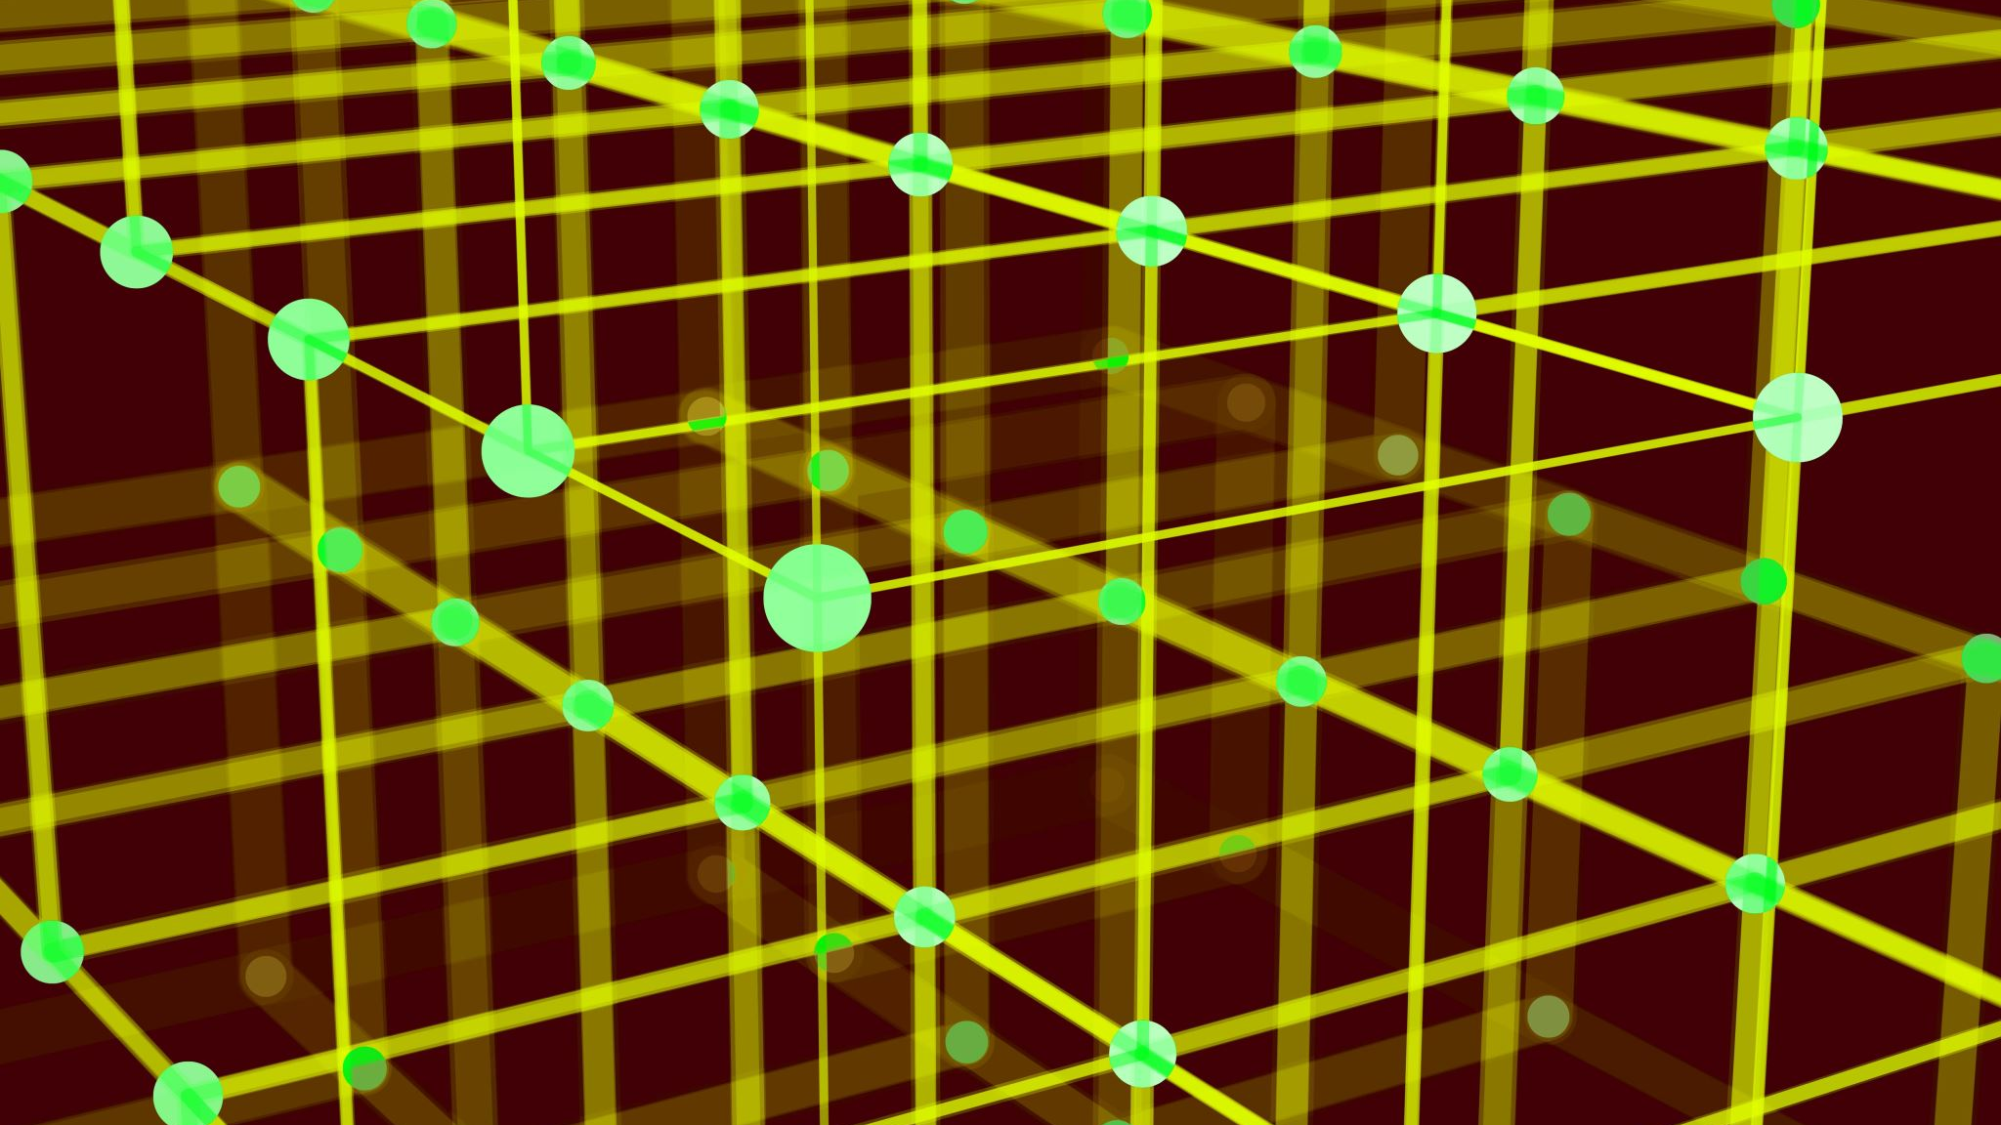
Neopixel Cube
By Team 16

Slide 2
Team Introduction
Our team consists of five members:
Project Manager – Tom Finance Manager – Sukhraj Manufacturer Manager – Harjoht Technical Manager – Isaac Market and Sales Manager – Adrian
While each of us had our own designated roles, we actively collaborated and supported one another across different aspects of the project

Slide 3
What is our project?
Our product is a 4x4x4 NeoPixel LED Cube, Consisting of 64 individually addressable RGB LEDs, controlled via an Arduino Uno Microcontroller.
Key Selling Points:
Capable of displaying a wide range of dynamic lighting effects and patterns.
User-controlled functionality, allowing selection of different lighting sequences.
Compact and Visually engaging, making it ideal for both educational and decorative purposes.
Target Market:
Our product is aimed at tech enthusiasts, students, hobbyists, and educators looking to explore programming, electronics and creative lighting displays.

Slide 4
How is our project different?
Unique Selling Point:
Unlike standard LED displays, our fully addressable 3D LED cube offers an immersive three-dimensional visual experience with customisable patterns and effects.
Our project stands out in a few key ways. For one, instead of simply following the typical LED cube design, we’ve integrated an LDR to automatically adjust brightness based on ambient light, which adds a smart, interactive twist. We’re also taking a more hands-on approach in the build – instead of using a pre-fabricated module, we’ve crafted a custom MDF base to neatly house the Arduino and breadboard, giving it a unique, polished look. Plus, while our competitors often stick to one-dimensional patterns, our design lets the user cycle through a range of dynamic sequences, making it not only visually engaging but also educational and versatile.

Slide 5
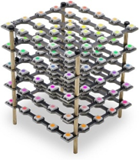
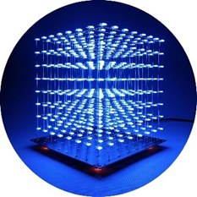
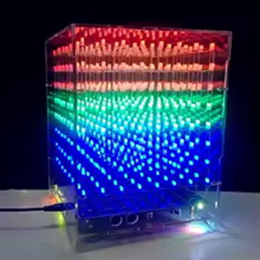
Market Overview
Overview of Similar Products on the Market:
There are several comparable products available, such as pre-built LED cubes and modular display systems aimed at hobbyists and educators. These devices typically offer a range of basic lighting effects, though they often lack the customisability and interactivity of our design
£21.99
Very little user interaction
£36.00
The LEDs have one fixed colour
£35.00
LEDs have a three fixed colours
Treedix Led Cube 5X5X5 Digital Individually Addressable with RGB Full-Colour, Starter Kit for Adults : Amazon.co.uk: Lighting
iCubeSmart 3D Led Cube DIY Electronics Kit Soldering Project Kit (3D8S-BLUE) : Amazon.co.uk: DIY & Tools
Cololful Light Cubes DIY Kit 8X8X8 WIFI Mobile Phone APP Change Word 888 LED Flashing Smart Electronic Production

Slide 6
Market Overview
Selling Prices:
Basic LED cubes usually retail for around £30 to £50, while more advanced versions—with additional features and greater programmability—can cost between £150 and £200 or more.
Market Size:
The market for DIY electronics and interactive LED displays is steadily growing. Driven by the maker movement, increased interest in STEM education, and the popularity of customisable smart home gadgets, this sector is expected to expand further in the coming years.

Slide 7
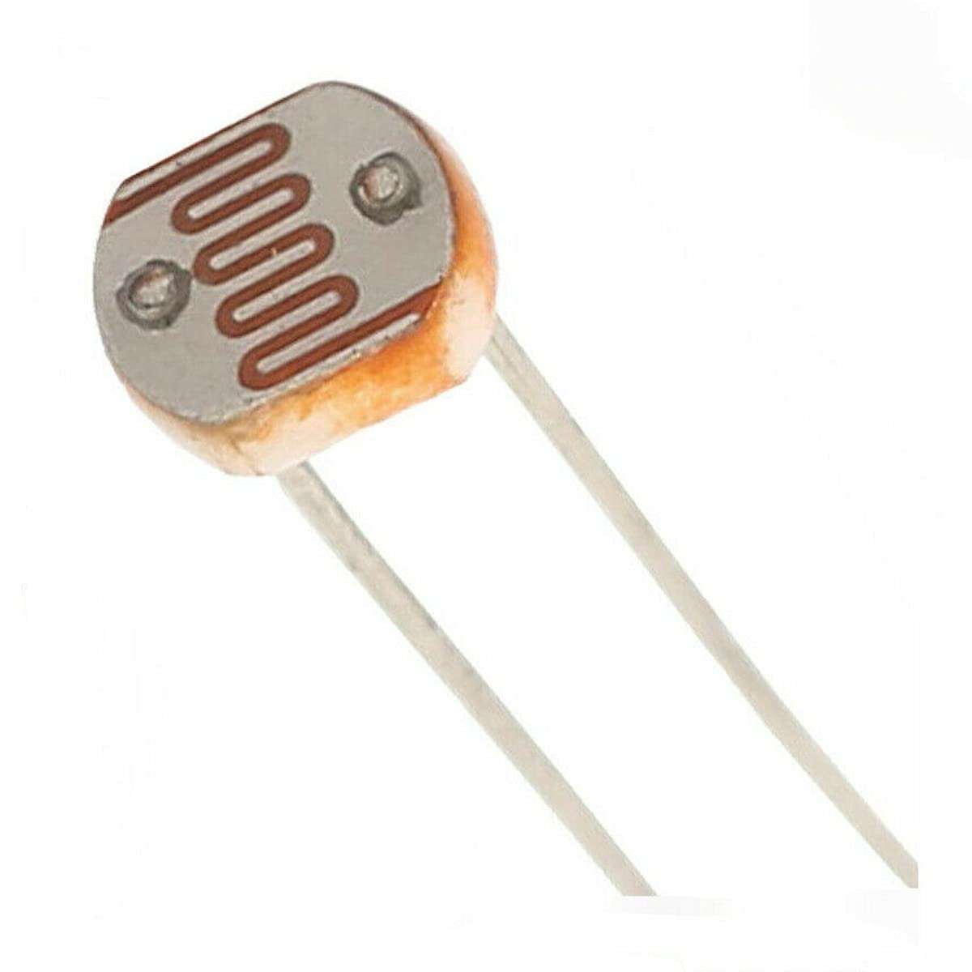
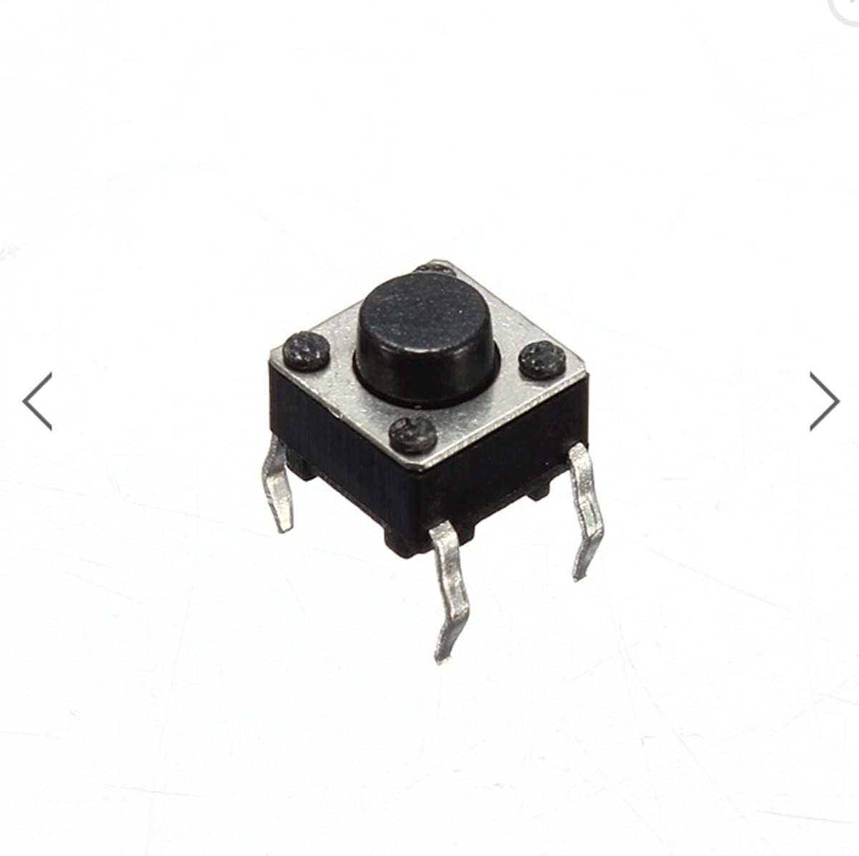
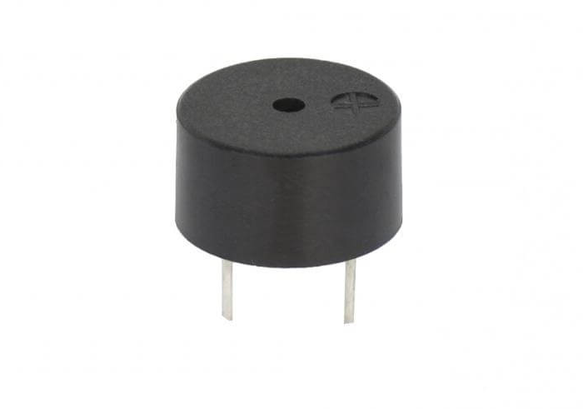
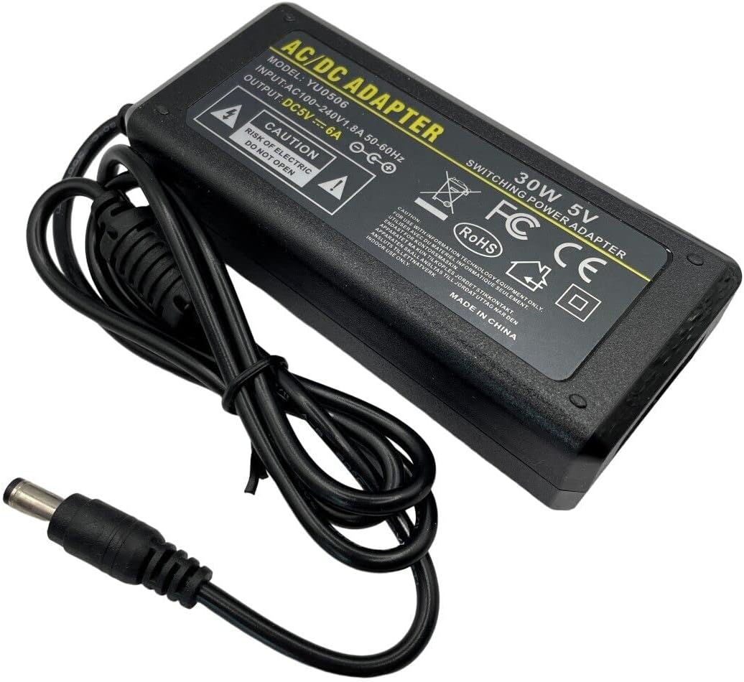
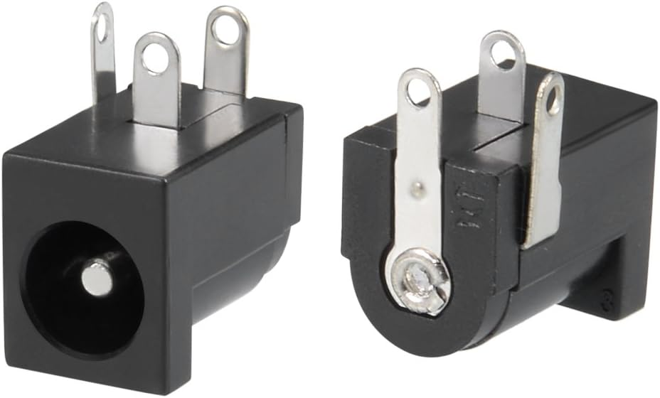
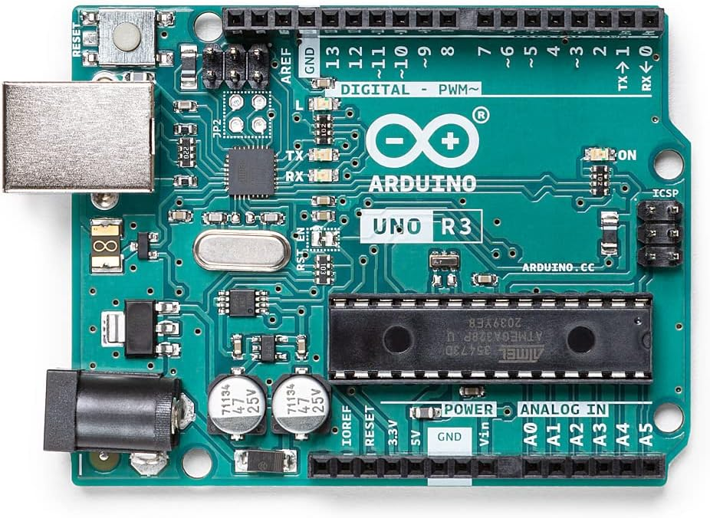
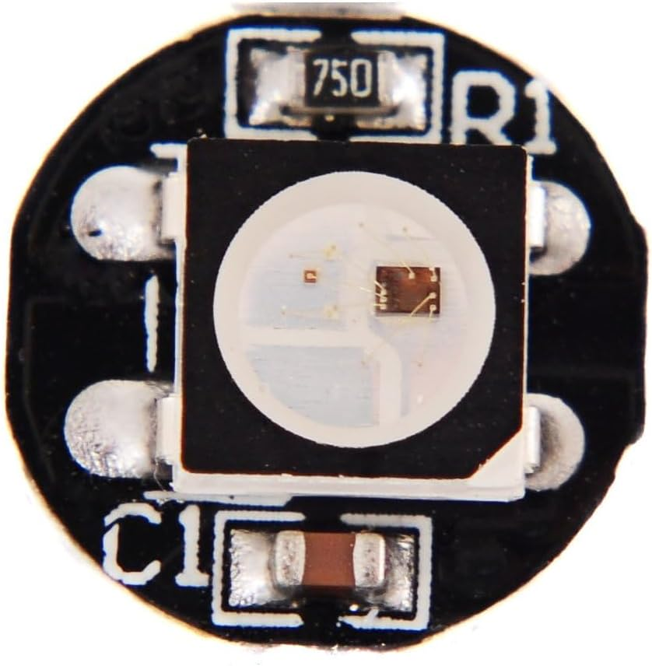
Hardware Overview Top level block diagram:
Input
Output
LDR
(Analogue Input)
Mini Push Button x2 (Digital Input)
Peizo Buzzer
Arduino UNO R3 Microcontroller
WS2812B Intelligent Control Integrated LED x64
Single Wire Control Protocol
5V 6A 30W PSU
DC Power Jack
5V 6A External Power Source

Slide 8
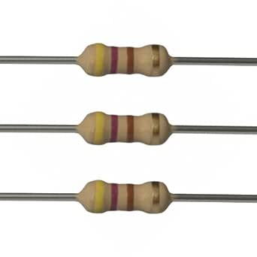
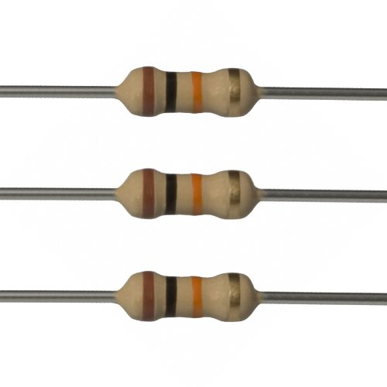
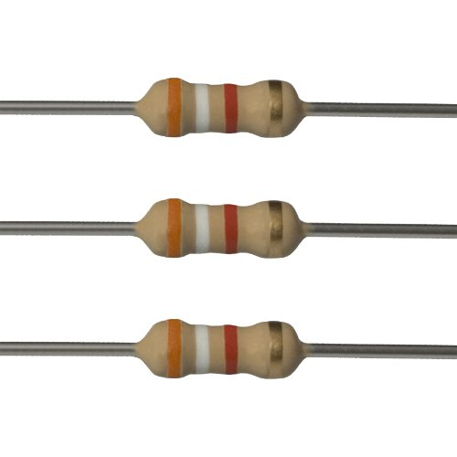
Hardware Summary Parts description:
Image | Name | Description
 | Arduino UNO R3 Microcontroller x1 | Controls Neopixels, allows buttons and LDR to control the cube
 | 5V 6A 30W PSU x1 | Powers Arduino and Neopixels, supplying sufficient current.
 | DC Power Jack x1 | Allows easy connection of power supply
Image | Name | Description
 | 470Ω Resistor x1 | Limits current of data pin
 | 10kΩ Resistor x2 | Pull down resistor, restricts current to ground when button pressed
 | 3.9kΩ Resistor x1 | Pull down resistor, used for LDR function by comparing potential differences
Notes:
Neo pixels – why we chose them what they do and their rating such as volatage and current
Power supply- what power supply we used and why and values of what it provides
PCB – why we chose this over the original idea of no pcb
Arduino – why we chose this over other possible programming languages

Slide 9
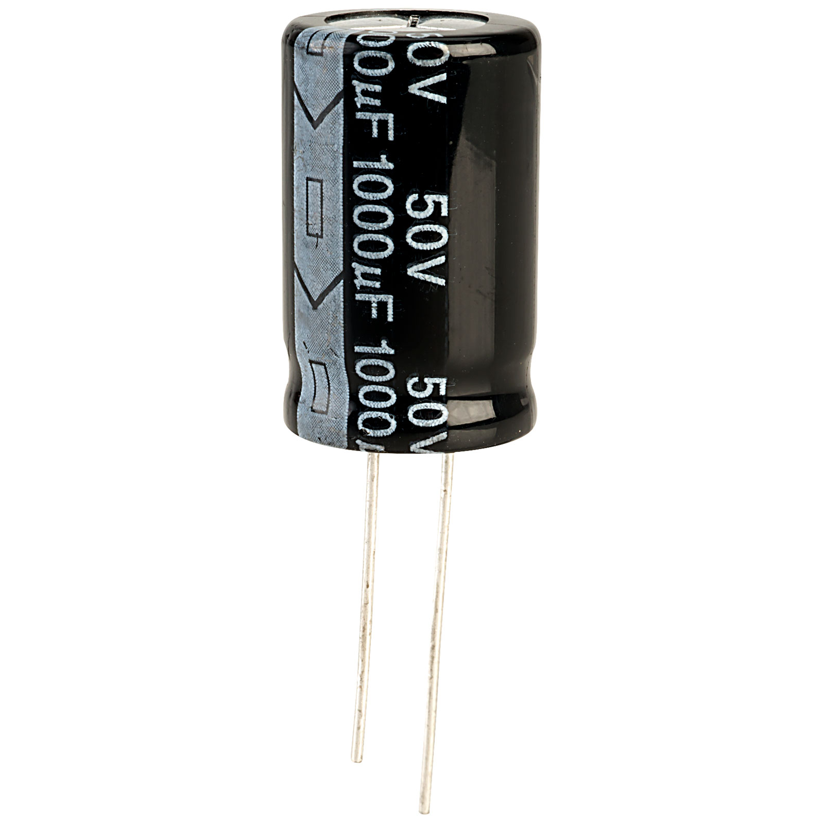
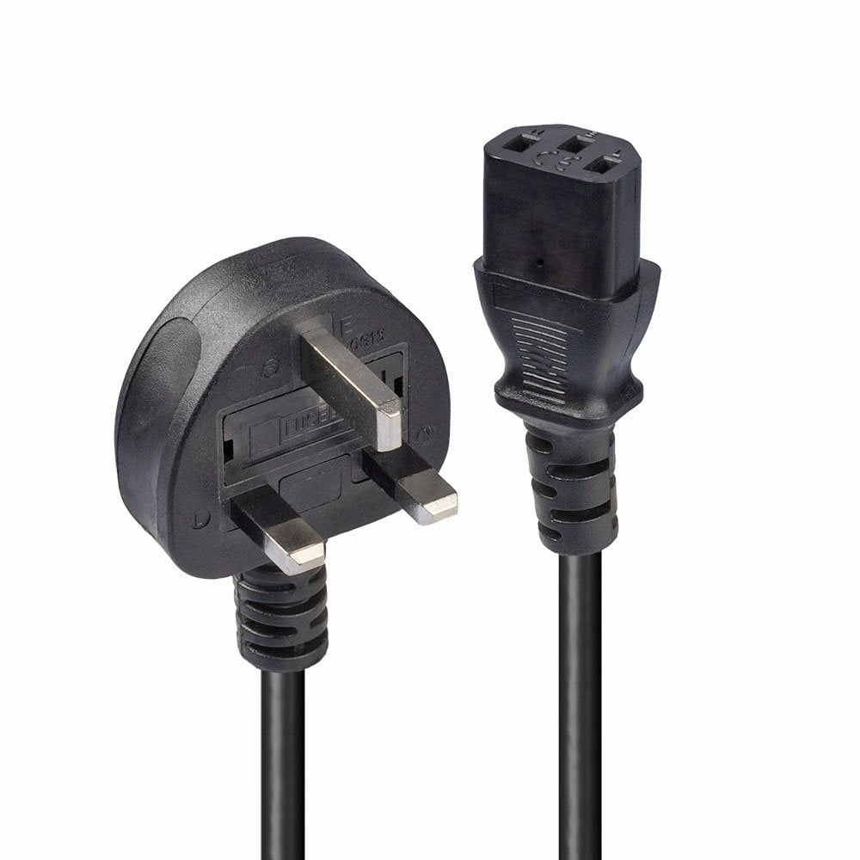
Hardware Summary Parts description:
Image | Name | Description
 | WS2812 Neopixels x64 | 4x4x4 cube made from these, individually addressable and RGB
 | 1000uF Capacitor x1 | Large amount of LEDS, so a capacitor is used for a more reliability
 | LDR x1 | Allows brightness of LEDS to change based on ambient light input
Image | Name | Description
 | Mini Push Button x2 | Allows user to control led patterns at to turn the LEDS on and off
 | Peizo Buzzer x1 | Verbal confirmation that the cube has been switched off
 | Power Supply To Mains Cable x1 | Allows power supply to be connected to mains power
Notes:
Neo pixels – why we chose them what they do and their rating such as volatage and current
Power supply- what power supply we used and why and values of what it provides
PCB – why we chose this over the original idea of no pcb
Arduino – why we chose this over other possible programming languages

Slide 10
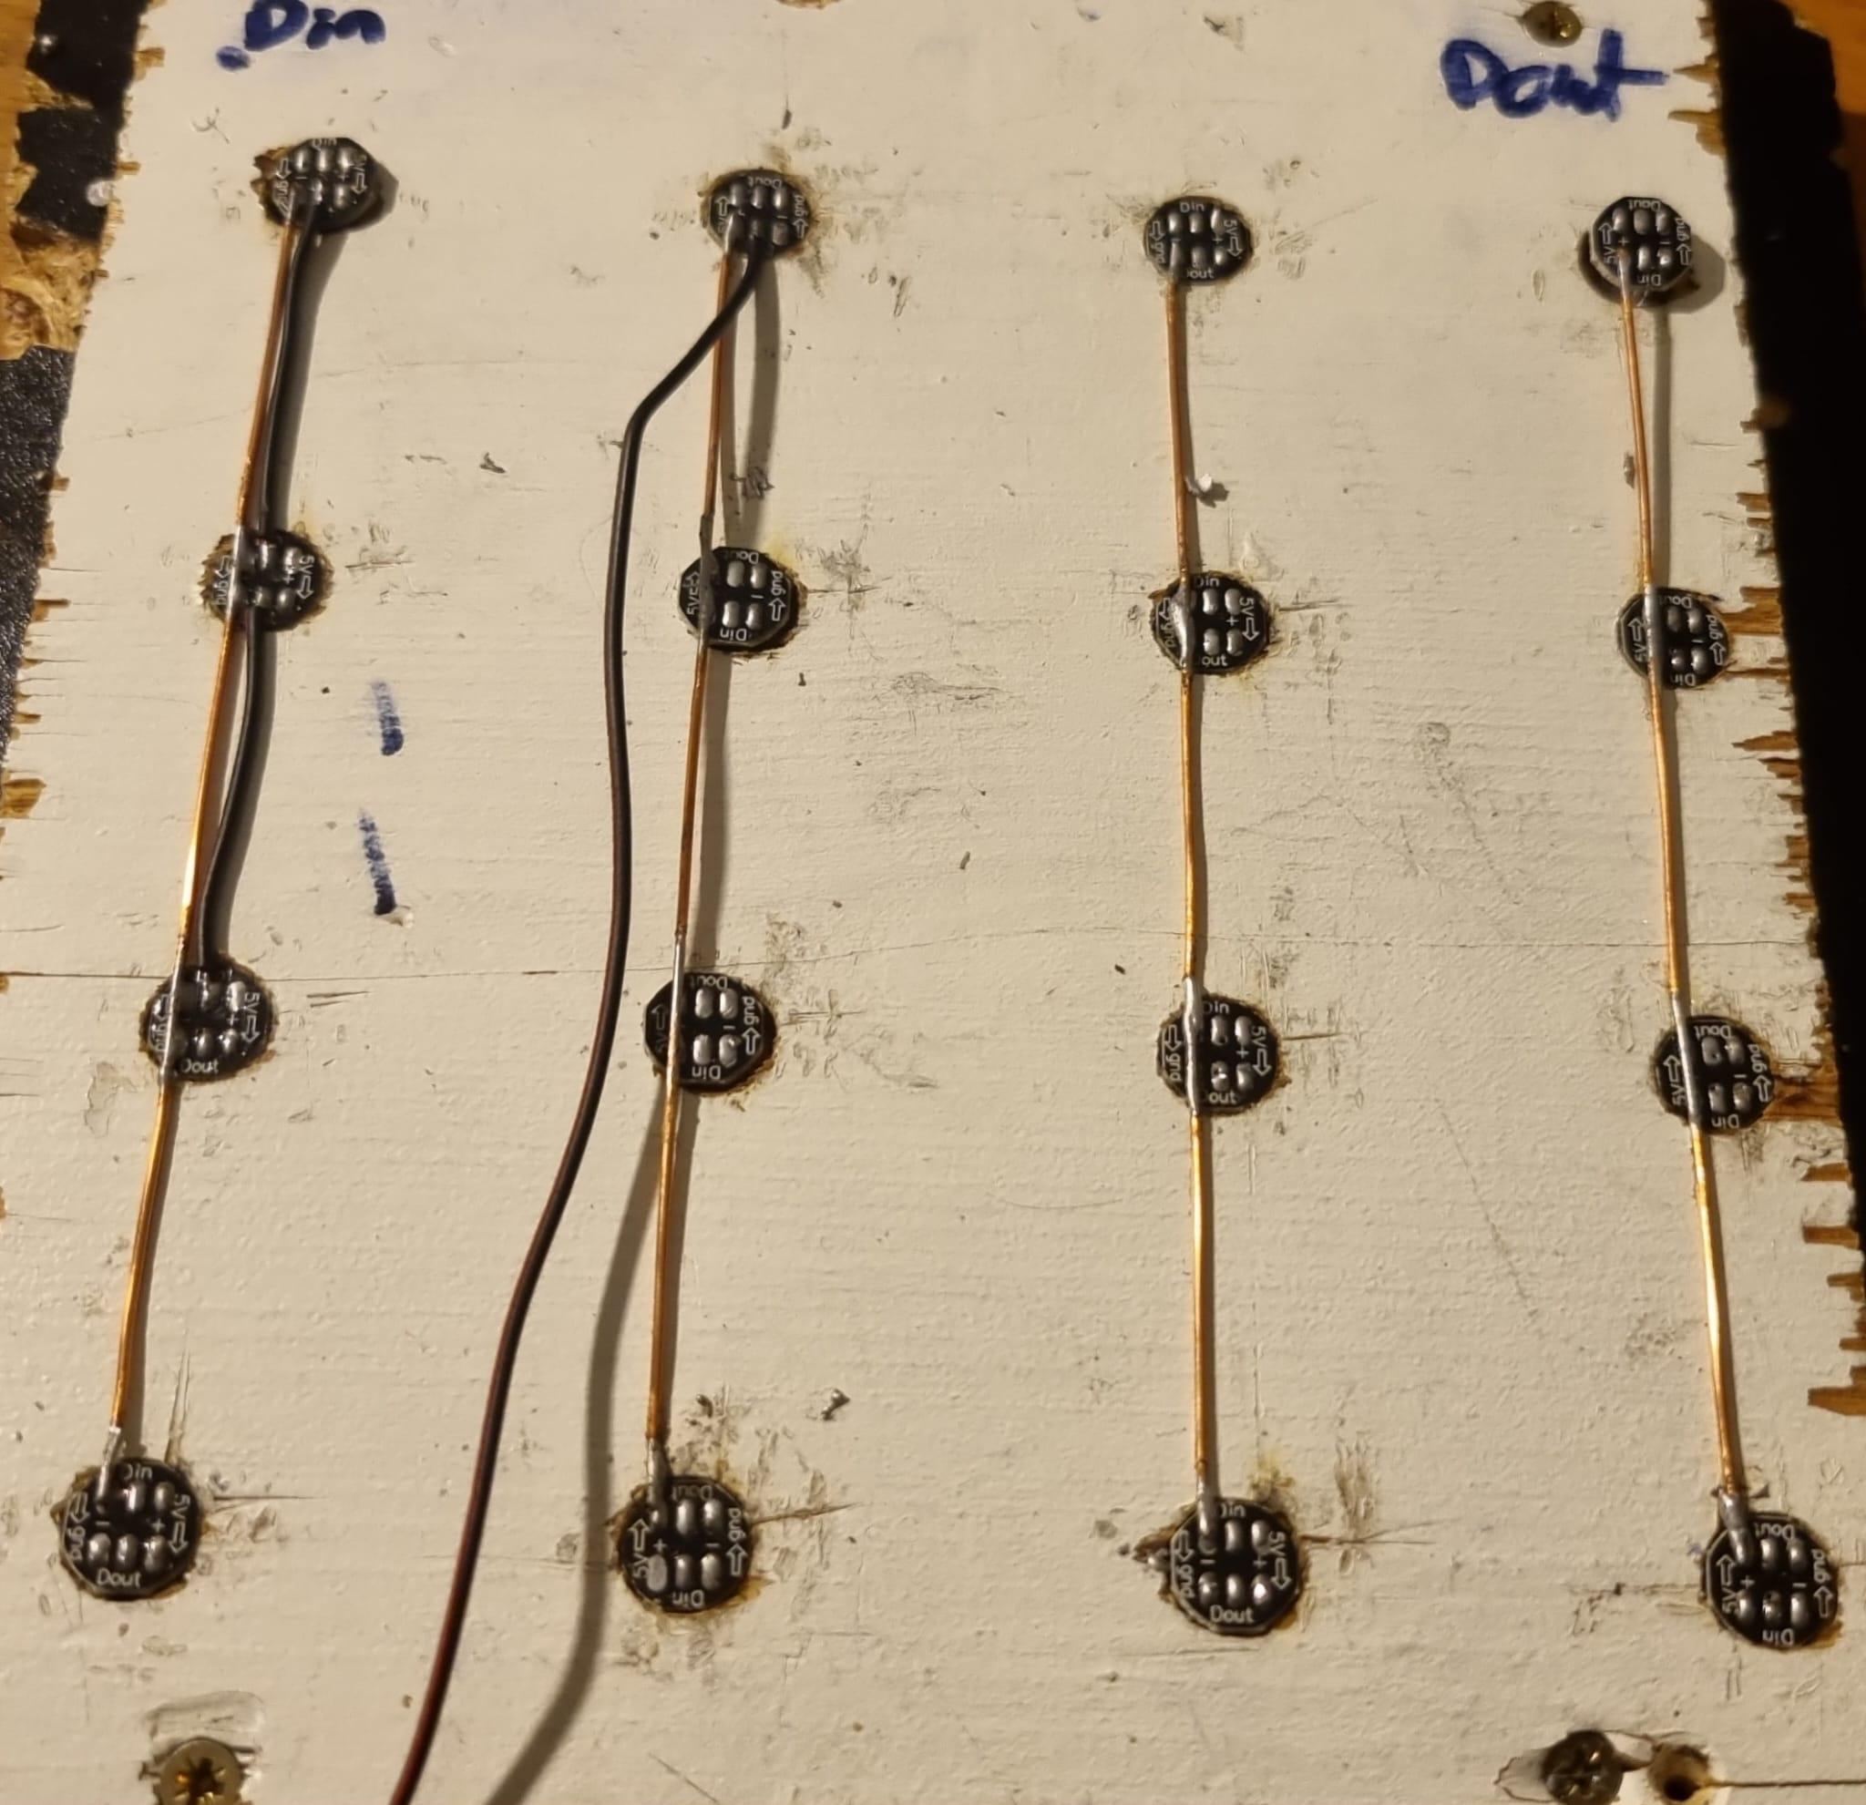
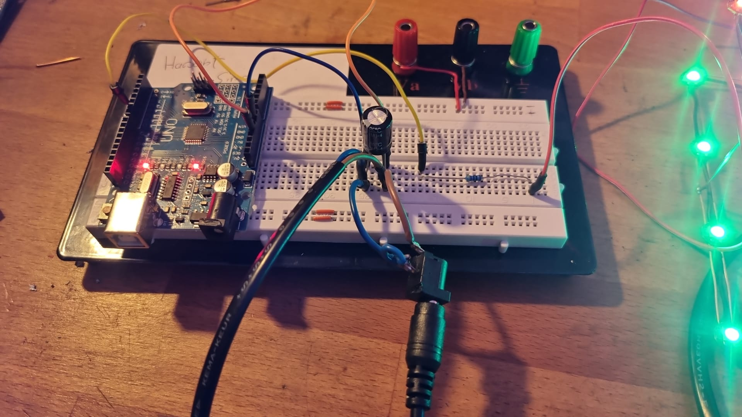
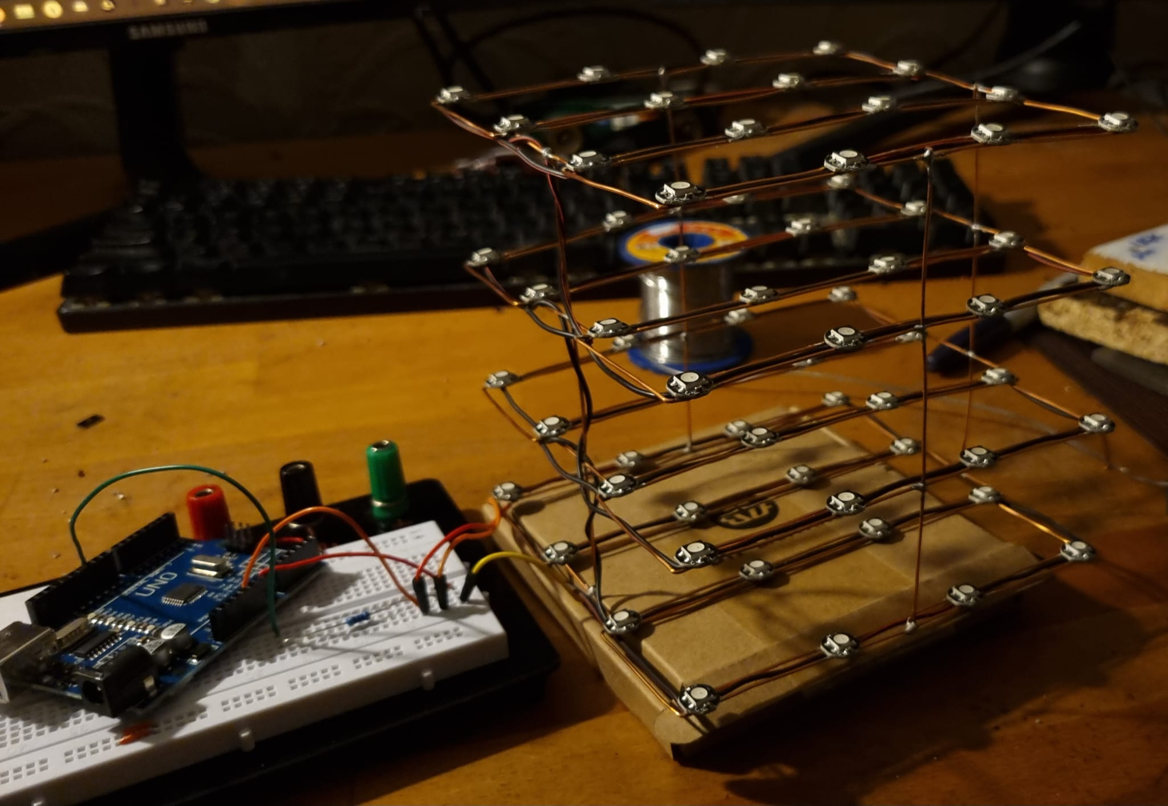
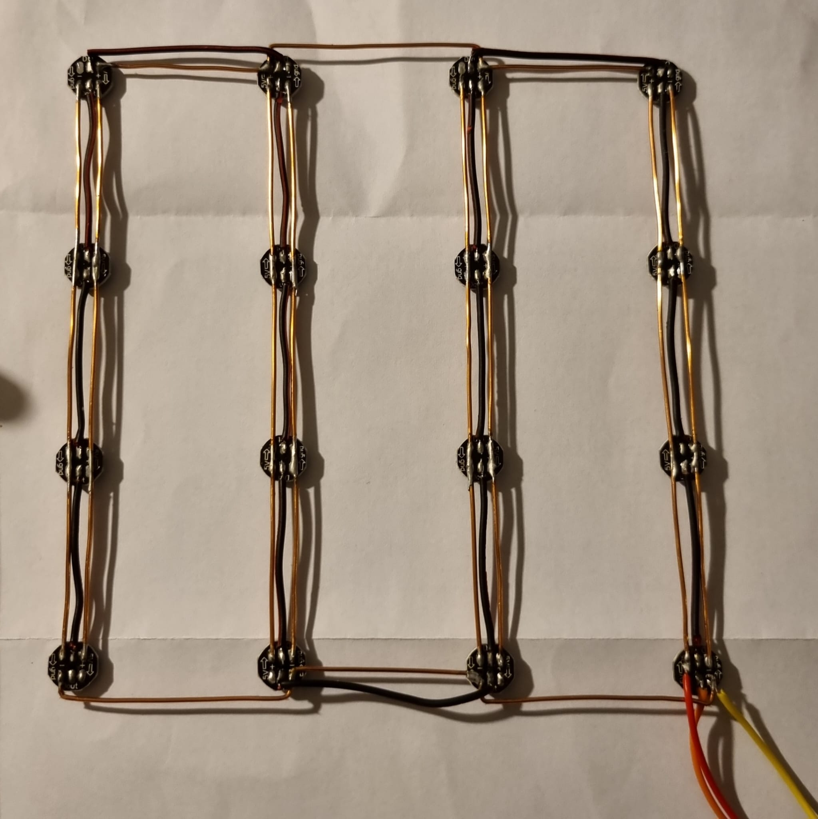
Hardware Summary Design choices:
Made from 4 main layers
Each layer has 4 sections
Constructed from copper wire, soldered to pads under LEDS
Simple template used for equal spacing
Thick wires used the Neopixel cube ground and +5V
Simple circuit which allows for one power source
Final cube is assembled with all 4 layers.
Layers joined with vertical animalised copper wire, soldered together with equal spacing
Each section joined up with more wire
Each layer joined up with a common ground and +5V
Between both rails, an insulated data wire is used which daisy chains each LED

Slide 11
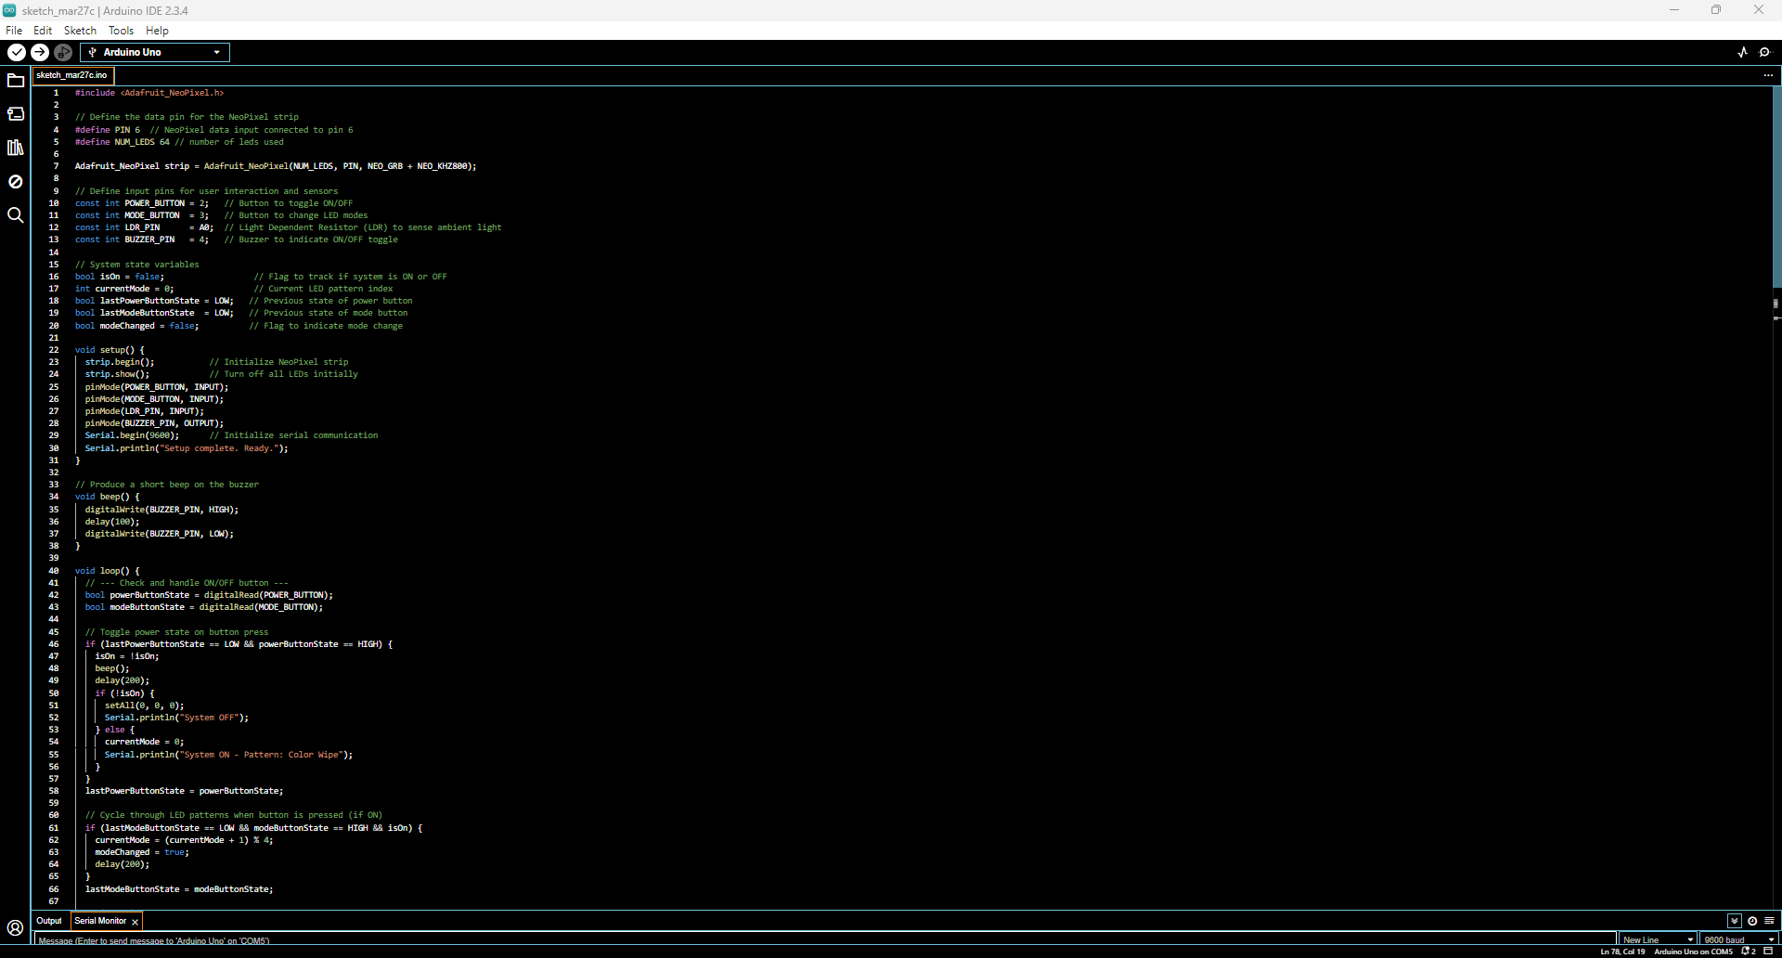
Software Overview
Code

Slide 12
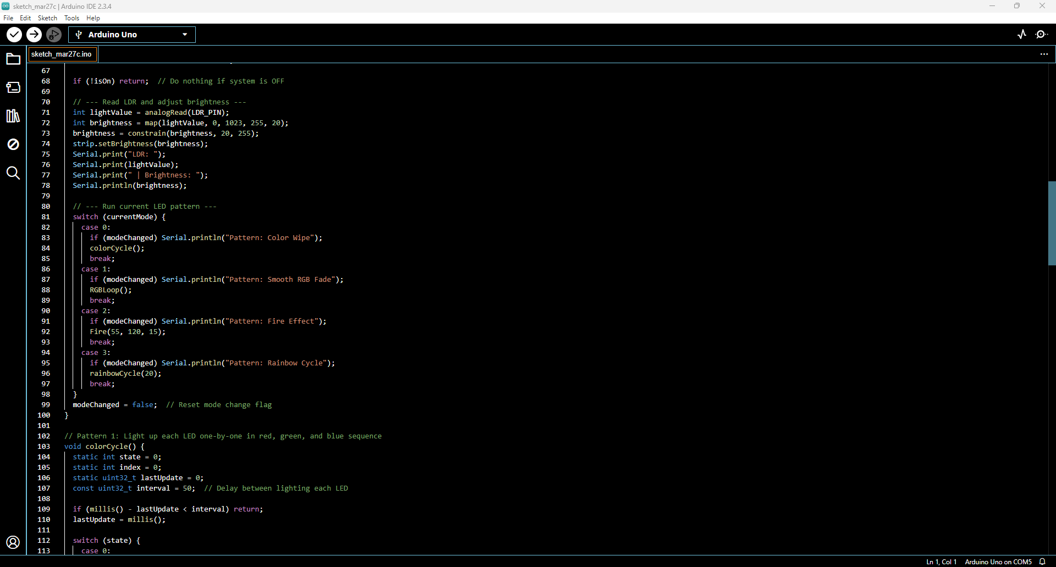

Slide 13
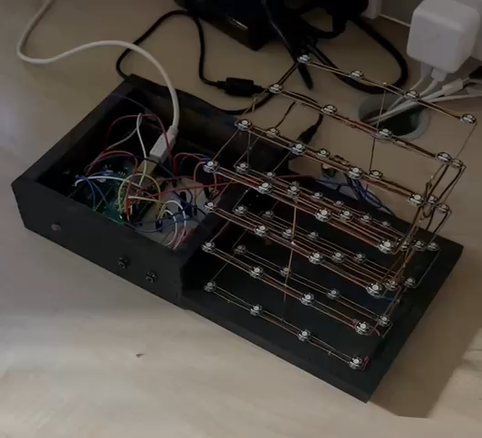
Video

Slide 14
This Arduino-based system code controls a 4x4x4 NeoPixel LED Cube with interactive features and dynamic lighting patterns. It includes the following:
Core Features
NeoPixel Strip Control: Manages 64 RGB LEDs using the Adafruit NeoPixel library.
Power Button (D2): Turns the LED cube on or off.
Mode Button (D3): Cycles through four lighting patterns.
LDR (A0): Adjusts LED brightness based on ambient light.
Buzzer (D4): Provides audio feedback when toggling power.
Serial Monitor Output: Displays current brightness, LDR values, and active pattern name.
LED Lighting Modes
Color Wipe (Pattern 1): LEDs light up one by one in Red, then Green, then Blue.
Smooth RGB Fade (Pattern 2): All LEDs gently fade in and out through Red, Green, and Blue.
Fire Effect (Pattern 3): Simulates flame-like flickering using a heat map algorithm.
Rainbow Cycle (Pattern 4): Displays a flowing rainbow effect across all LEDs.

Slide 15

Access the Full Arduino Code
Scan the QR code on the left or visit the link below to view the complete source code for our NeoPixel Cube project
-https://pastebin.com/H5fWksem

Slide 16
Software block diagram
Import libraries
Define constants (LED pins, button pins, LDR threshold, etc.)
Declare variables
Loop:
Read button states
Read ambient light level from LDR
Adjust brightness accordingly
Run cube patterns
Reset cube if needed
Setup:
Turn off all LEDs
Initialise X, Y, Z positions
Set up button inputs
Configure LDR for ambient light detection
Functions:
Reset Cube – Turns off all LEDs and resets positions
Function: Button Control – Checks button presses to change patterns
Function: Adjust Brightness – Uses LDR input to control LED brightness

Slide 17
Finance
Development Costs
Component | Cost per Unit (£) | Quantity | Total Cost (£)
BTF-LIGHTING WS2812B ECO RGB LEDs (100pcs) | 11.99 | 1 | 11.99
Electronic Buzzer (10pcs) | 8.35 | 1 | 8.35
Solder Flux Paste (10g) | 3.69 | 2 | 7.38
Copper Wire (10m x 0.9mm) | 6.79 | 1 | 6.79
5V 6A 30W Power Adapter | 11.98 | 1 | 11.98
DC Power Jack (15pcs) | 5.09 | 1 | 5.09
Resistors, Capacitors, Buttons, LDRs | 1 | 8 | 8
MDF (Case Material) | 13 | 1 | 13
Arduino UNO R3 | 22.01 | 1 | 22.01
 |  | Sub total | 94.59
Labour Costs (£16/hour)
Task | Hours | Cost per Hour (£) | Total Cost (£)
Cube Soldering | 4 | 16 | 64
Market Research | 2 | 16 | 32
Regulation Research | 1 | 16 | 16
Testing Cube | 1 | 16 | 16
Writing Code | 3 | 16 | 48
Marketing Video | 1 | 16 | 16
Total Labour Cost | 12 |  | £192
Total development cost | £287

Slide 18

Component | Cost (1 unit) | Cost (100 units) | Cost (500 units) | Cost (1000 units)
Arduino UNO R3 | £22.01 | £20.00 | £18.50 | £17.00
5V 6A 30W PSU | £11.98 | £10.50 | £10.00 | £9.50
DC Power Jack | £5.09 | £4.50 | £4.00 | £3.50
WS2812 NeoPixels (x64) | £11.99 | £10.80 | £10.00 | £9.50
Other Resistors/Capacitors | £0.95 | £0.80 | £0.75 | £0.70
Buttons (x2) | £0.40 | £0.35 | £0.30 | £0.25
LDR | £0.50 | £0.45 | £0.40 | £0.35
Piezo Buzzer | £1.00 | £0.90 | £0.85 | £0.80
1000µF Capacitor | £0.30 | £0.25 | £0.20 | £0.20
MDF Case | £13.00 | £12.50 | £12.00 | £11.50
Power Cable | £2.00 | £1.80 | £1.70 | £1.60
Total Cost per Unit | £69.22 | £62.85 | £58.70 | £54.90
As we started looking into manufacturing costs, we noticed that buying in bulk makes a huge difference. The more units we produce, the cheaper each one gets because suppliers offer discounts on large orders. For example, the Arduino UNO R3 costs £22.01 when buying one, but at 1000 units, the price drops to around £17 each.
Other components like LEDs, power adapters, and buttons also get cheaper in bulk. This shows that scaling up production makes the project much more affordable and realistic if we were to sell it.

Slide 19
Future developments
For future designs we can:
Increase the scale of our design to 8x8x8 or even 16x16x16
Add a wider range of different patterns/sequences the user can cycle through
Surround the LEDs with a protective case which reduces the risk of mechanical damage whilst also improving the products aesthetic
Improve the quality of the components used e.g. buttons, LDR and casing
Create custom PCB so that less wiring is needed inside the case

Slide 20
Personal improvements
Improve task prioritisation and avoid leaving work to the last minute
Utilise project management tools to stay organised
Set clear goals and ensure they are met
Be more proactive when sharing ideas
Maintain a positive attitude and ensure we're always motivated

Slide 21
What went well
Overall, the project was successful, and we all gained/improved a wide range of different skills, including:
Consistent communication
Timely updates and immediate resolution of problems
Developed our problem-solving skill
Ensured that we followed all health and safety guidelines/regulations
Engaging in team planning sessions which led to innovative design choices
Developed assembly skills by implementing meticulous soldering techniques

Slide 22
Thanks for listening
Any Questions/Suggestions?

